Slide 1
HOUSING PRICE PREDICTION PROJECT
BY SANJAY SIVAKUMAR

Slide 2
BACKGROUND OF THIS PROJECT
Houses are one of the necessary need of each and every person around the globe and therefore housing and real estate market is one of the markets which is one of the major contributors in the world’s economy.
Predictive modelling, Market mix modelling, recommendation systems are some of the machine learning techniques used for achieving the business goals for housing companies. Our problem is related to one such housing company.
For this company wants to know:
1.Which variables are important to predict the price of variable?
2.How do these variables describe the price of the house?

Slide 3
PROBLEM FRAMING
A US-based housing company named Surprise Housing has decided to enter the Australian market.
The company uses data analytics to purchase houses at a price below their actual values and flip them at a higher price.
For the same purpose, the company has collected a data set from the sale of houses in Australia.
Real estate is a very large market and there are various companies working in the domain.
Data science comes as a very important tool to solve problems in the domain to help the companies increase their overall revenue, profits, improving their marketing strategies and focusing on changing trends in house sales and purchases.

Slide 4
HARDWARE AND SOFTWARE REQUIREMENTS
Programming language – python 3.0
Libraries and Packages
1.pandas- for data framing the dataset
2.numpy- for any analytical functions
3.seaborn and matplotlib-for visualization process
4.train_test_split- for splitting data into training and testing
5.And I have imported regression algorithms such as Random Forest Regressor , KNeighbors Regressor etc… for model building.
6.And finally imported metrics for regression problem for proper model selection.

Slide 5
TECHNIQUES AND METHODS USED
1. Z-Score method -> for removing skewness/outliers
2. Box-Cox transformation -> for removing skewness/outliers
3. Correlation method -> for analysing the correlation of input columns with our target column
4. VIF method-> to check for any multicollinearity present in our input columns
5. Standard Scaler method- >to standardize our input column data.

Slide 6
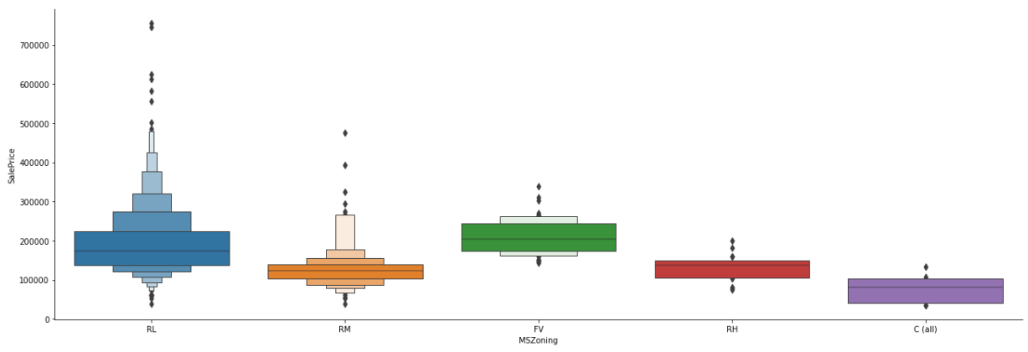

Slide 7
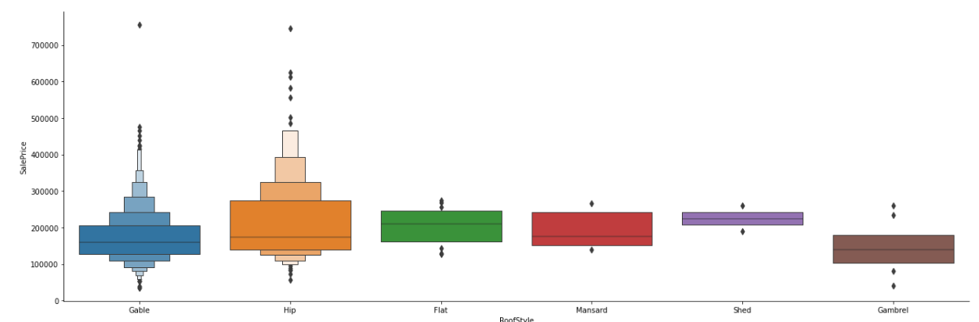

Slide 8
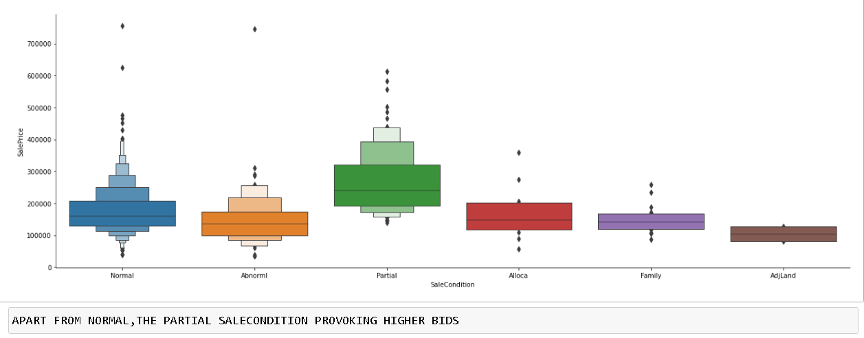

Slide 9
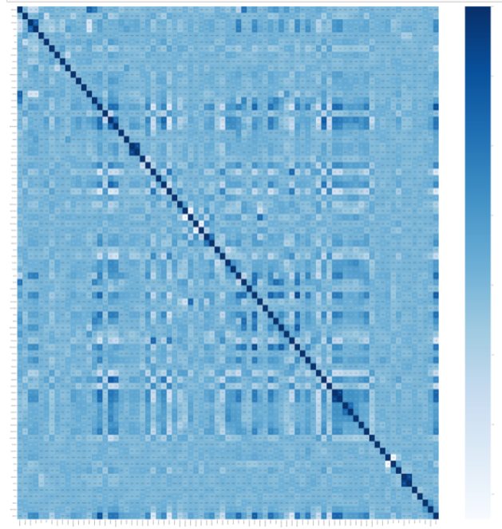
FROM THE CORRELATION GRAPH
CORRELATION GRAPH
-I have found that the columns,
"LotShape",
"ExterQual",
"BsmtQual",
"BsmtExposure",
"HeatingQC”.
"KitchenQual",
"GarageType",
"GarageFinish" doesn’t much affect the sale price of the house.
-And the columns,
"OverallQual",
"YearBuilt",
"YearRemoteAdd",
"1stFlrSF",
"GrLivArea",
"FullBath",
"TotRmsAbvGrd",
"Fireplaces",
"GarageCars",
"Garage Area",
"OpenPorchSF" affects more our target column.
Thus, these columns are the vital parameters to be considered by the company.

Slide 10
ALGORITHMS USED FOR MODEL BUILDING
1.Linear Regression
2.Decision Tree Regressor
3.Random Forest Regressor
4.KNeighbors Regressor
5.Standard Vector Regressor

Slide 11
KEY METRICS USED
1. r2 score-> to know the accuracy of the model
2. Mean squared error-> provides us the error present in the model

Slide 12
FINAL MODEL-RANDOM FOREST REGRESSOR
IT HAS LESS DIFFERENCE BETWEEN THE TESTING AND TRANING SCORE
IT HAS LESS DIFFERENCE BETWEEN ACTUAL ACCURACY AND CROSS-VALIDATION MEAN SCORE

Slide 13
CONCLUSION
After my final model I got a accuracy which is partially good in this scenario and this accuracy can be further increased by adding more columns and using advanced Feature Engineering techniques to this dataset.

